Slide 1
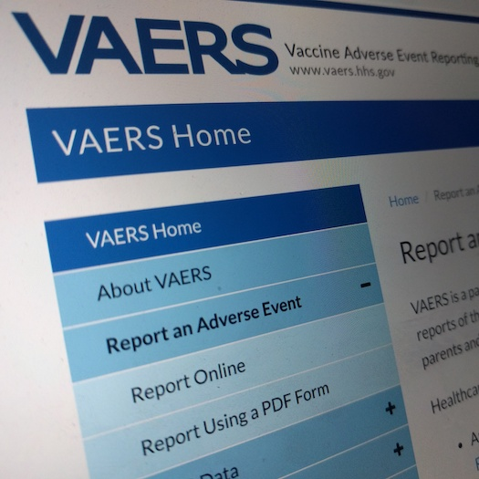
Vaccine Adverse Event Reporting System
Analysis of adverse event reports
after Covid-19 vaccination

Slide 2
The CDC and FDA analyze VAERS for safety signals
VAERS
VAERS is an important vaccine safety assessment tool. In fact…
CDC study using VAERS
J.R. Su, M.M. McNeil, K.J. Welsh, et al. Myopericarditis after vaccination, vaccine adverse event reporting system (VAERS), 1990–2018. Vaccine 39 (2021) 839–845.
The CDC recently analyzed VAERS to assess reports of myopericarditis following vaccination.
The FDA analyzed VAERS to determine the onset interval of thrombocytopenia (ITP) following MMR vaccination.
FDA study using VAERS
S.K. Winiecki. Adverse Event Reporting: VAERS and WONDER. Center for Biologics Evaluation and Research, U.S. Food and Drug Administration, 2012.
The CDC’s and FDA’s use of the VAERS database is evidence that VAERS is a valid and credible resource.
Copyright © NZM. All Rights Reserved.

Slide 3
*726,965 adverse events after Covid-19 vaccination
Type of Adverse Event | Total Reports | Percent of Total
Any Event | 752,803 | 100%
Emergency Room | 85,321 | 11.3%
Hospitalization | 71,036 | 9.4%
Disabled | 22,342 | 3.0%
Death | 15,937 | 2.1%
● 71,036 VAERS reports after Covid vaccination required hospitalization.
● 15,937 VAERS reports after Covid vaccination were fatal.
*Data obtained from VAERS through September 24, 2021.
Copyright © NZM. All Rights Reserved.

Slide 4
*71,036 hospitalizations after Covid-19 vaccination
Onset interval Post-vaccination | Hospitalizations (Cumulative) | Cumulative % of total events
Day of Vaccination | 13,806 | 19.4%
Day 3 | 26,228 | 36.9%
Day 7 | 35,029 | 49.3%
Total (Days 8+) | 71,036 | 100%
● 36.9% of all hospitalizations reported to VAERS after Covid-19 vaccination occurred within 3 days.
● 49.3% occurred within 7 days
*Data obtained from VAERS through September 24, 2021.
Copyright © NZM. All Rights Reserved.

Slide 5
*15,937 deaths after Covid-19 vaccination
Onset interval Post-vaccination | Deaths (Cumulative) | Cumulative % of total events
Day of Vaccination | 2094 | 13.1%
Day 3 | 5272 | 33.1%
Day 7 | 7314 | 45.9%
Total (Days 8+) | 15,937 | 100%
● 33.1% of all deaths reported to VAERS after Covid-19 vaccination occurred within 3 days.
● 45.9% occurred within 7 days.
*Data obtained from VAERS through September 24, 2021.
Copyright © NZM. All Rights Reserved.

Slide 6
*Severity of select adverse events after Covid-19 vaccination, per age group
Age | Disabled/ Total Reports | Hospitalized/ Total Reports | Deaths/ Total Reports
12-17 | .006 (122/21,839) | 6.5% (1030/21,839) | .001 (28/21,839)
18-44 | 2.2% (5203/232,975) | 5.2% (12,128/232,975) | .002 (578/232,975)
45-64 | 2.6% (5228/201,595) | 6.9% (13,873/201,595) | .009 (1754/201,595)
65-74 | 2.3% (1970/85,088) | 10.5% (8956/85,088) | 2.6% (2217/85,088)
75+ | 2.7% (1564/57,193) | 20.7% (11,852/57,193) | 9.4% (5354/57,193)
● Older age groups were the most likely to have serious adverse events after Covid vaccination.
*Data obtained from VAERS through September 24, 2021.
Copyright © NZM. All Rights Reserved.

Slide 7
*Severity of Covid-19 vaccination in older age groups
Although the elderly are most at risk of serious harm from a Covid infection, the vaccine appears to be especially dangerous in elderly age groups.
*Data obtained from VAERS through September 17, 2021.
Copyright © NZM. All Rights Reserved.

Slide 8
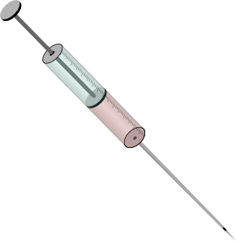
Covid-19: Definition of “Fully Vaccinated”
● People are considered “fully vaccinated” 2 weeks after their second dose (in a 2-dose series) or 2 weeks after their first dose (when only 1 dose is required).
It is
Scientific Fraud
to record a vaccinated person as unvaccinated.
Unvaccinated
Partially Vaccinated
Dose 1 1-14 days 15-28 days Dose 2 2 weeks
Fully Vaccinated
Unvaccinated
Dose 1 2 weeks
When someone catches covid, is hospitalized or dies during the 2-week gap after vaccination, it is recorded as having occurred in an unvaccinated person!
Fully Vaccinated
● People are considered “unvaccinated” when adverse events or cases of Covid occur during the 2-week gap!
MMWR 2021 Aug 27; 70(34)
Copyright © NZM. All Rights Reserved.

Slide 9
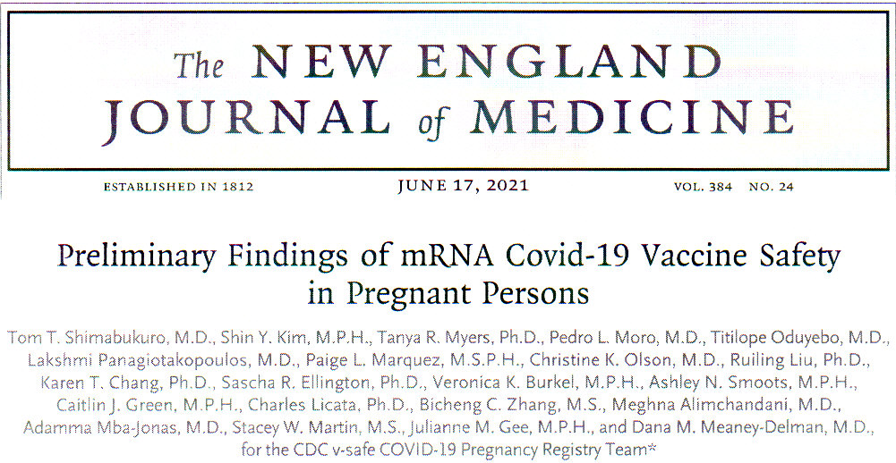
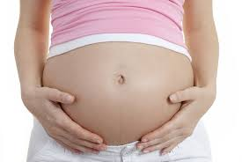
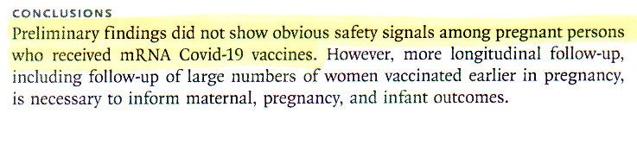
The CDC & FDA analyzed data on the safety
of Covid-19 vaccination during pregnancy
● The CDC & FDA conducted a safety study of 827 pregnant women who received a Covid vaccine.
However…
Copyright © NZM. All Rights Reserved.

Slide 10
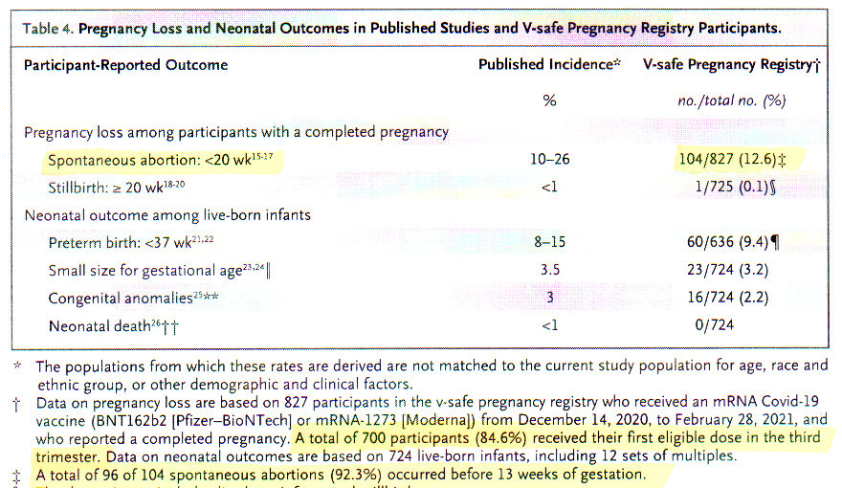
The CDC/FDA study on Covid-19 vaccination during pregnancy was deceptive
Table 4 tells the full story.
There were 104 spontaneous abortions out of 827 vaccinated pregnant women (12.6%)
But 700 of these women were not vaccinated until the third trimester.
Only 127 women were vaccinated early enough
to have a spontaneous abortion (104/127 = 81.9%).
Copyright © NZM. All Rights Reserved.

Slide 11

The CDC, FDA, and WHO are non-Transparent
● The CDC, FDA, and WHO control all of the data.
● We the People MUST have access to all of the data.
● Independent researchers and scientists must demand complete transparency and access to all safety and efficacy data.
Copyright © NZM. All Rights Reserved.

Slide 12
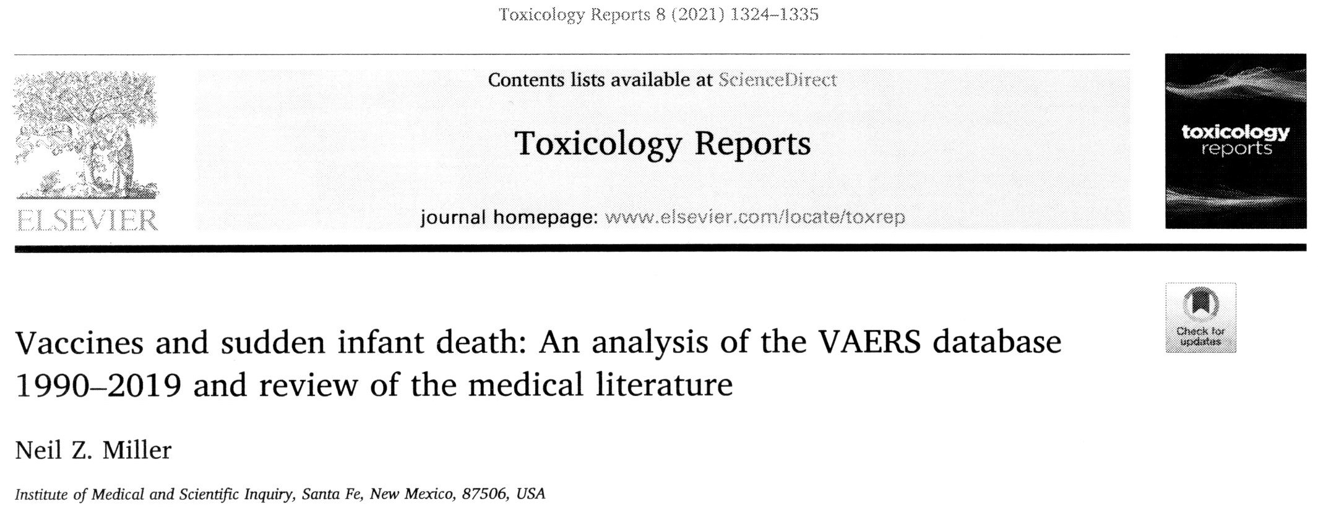
Copyright 2021 © NZM. All Rights Reserved.

Slide 13
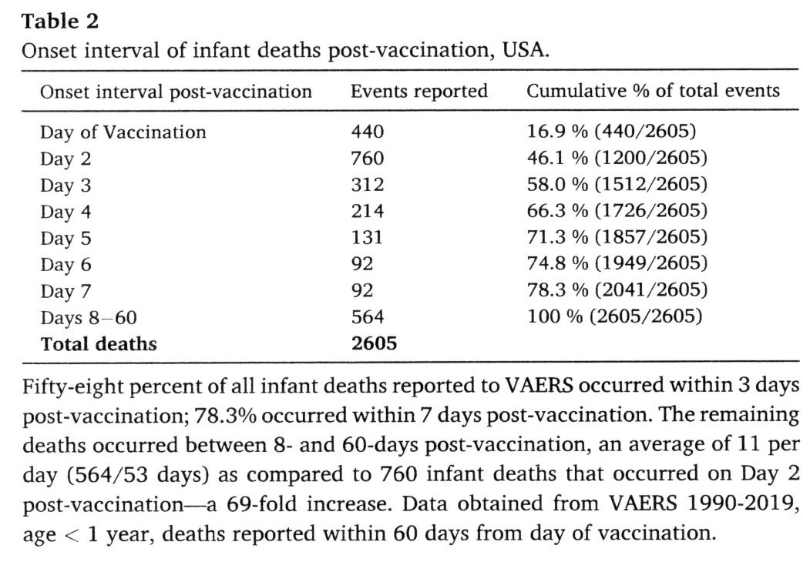
Miller NZ, Vaccines and Sudden Infant Deaths (2021 study)
Miller NZ. Vaccines and sudden infant death: an analysis of the VAERS database 1990-2019 and review of the medical literature. Tox Rep 2021; 8: 1324-1335.
• Of 2605 infant deaths reported to VAERS from 1990-2019, 58% clustered within 3 days post-vaccination.
• 78% of infant deaths reported to VAERS clustered within 7 days post-vaccination.
• This analysis confirms that infant deaths tend to occur in temporal proximity to vaccine administration
— a statistically significant finding (p < 0.00001).
Copyright © NZM. All Rights Reserved.

Slide 14
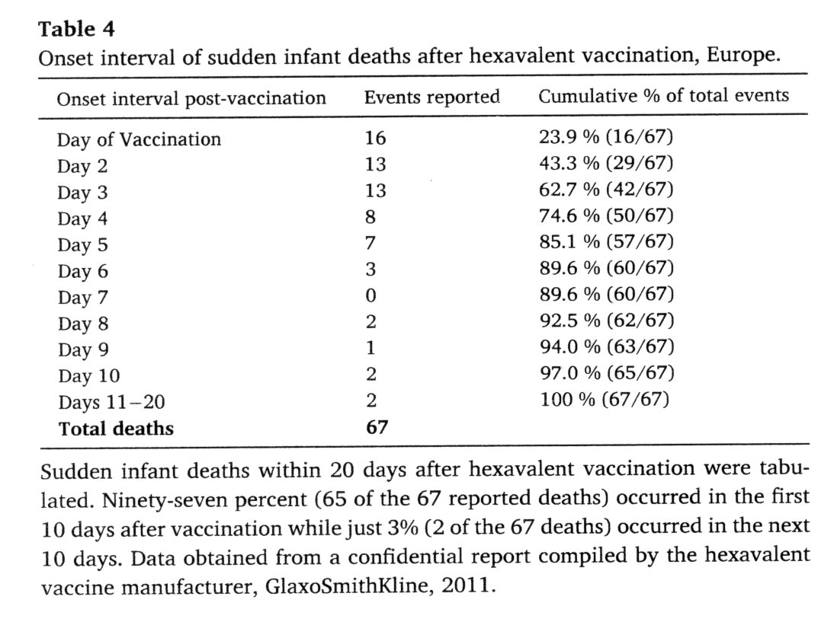
Confidential Report by Vaccine Manufacturer
97% of sudden infant deaths occurred in the first 10 days.
Just 3% occurred
in the next 10 days
Copyright © NZM. All Rights Reserved.

Slide 15
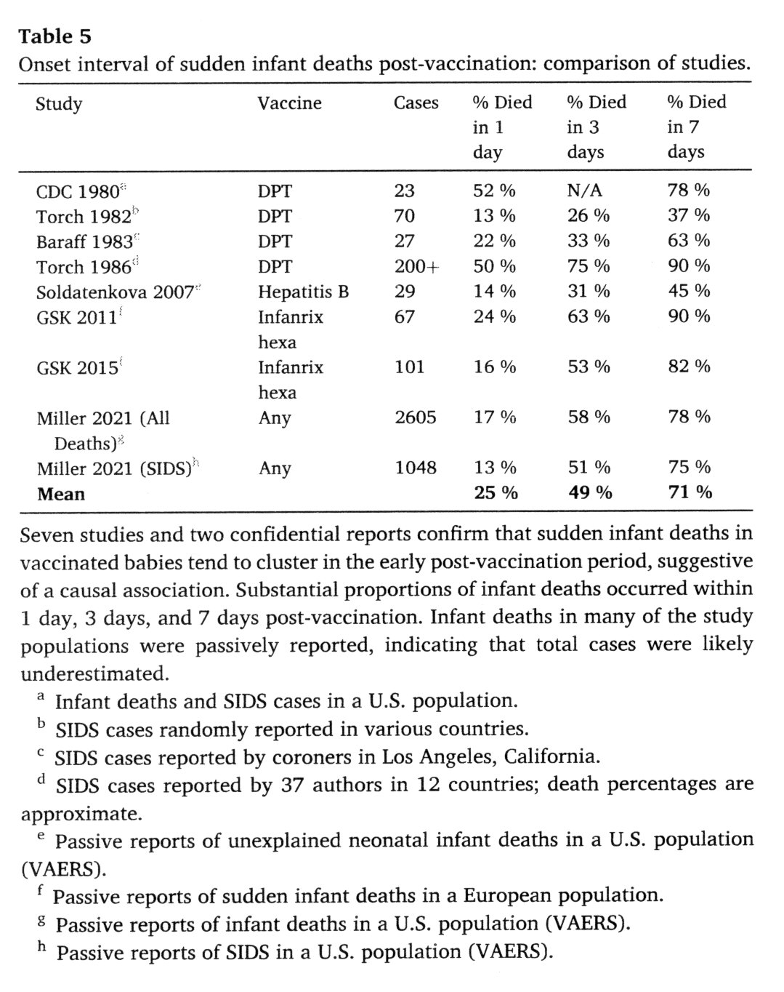
Vaccines and
Sudden Infant Deaths: Comparison
of Studies
• Seven studies
and two confidential reports confirm that sudden infant deaths in vaccinated babies tend to cluster in the early post-vaccination period, suggestive of a causal association.
Copyright © NZM. All Rights Reserved.

Slide 16
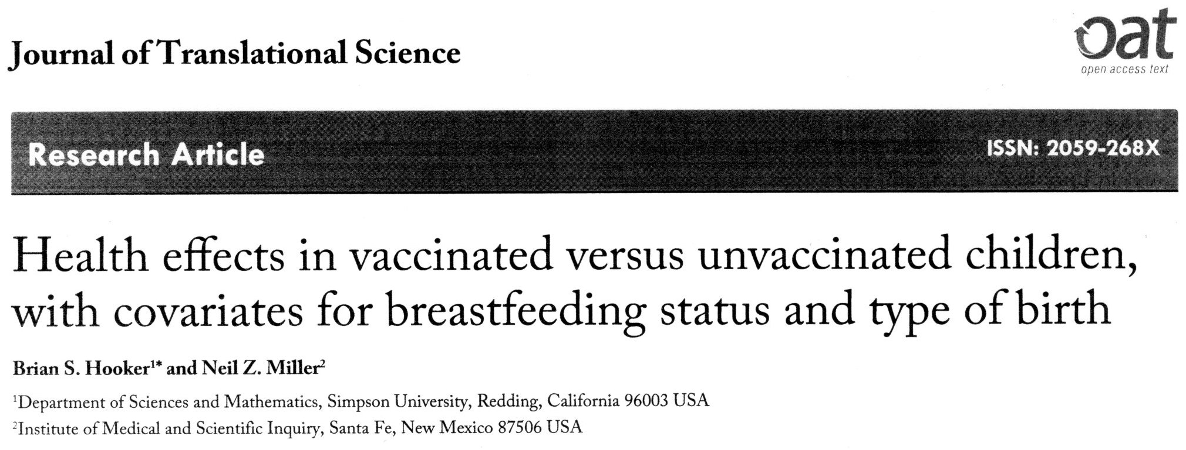
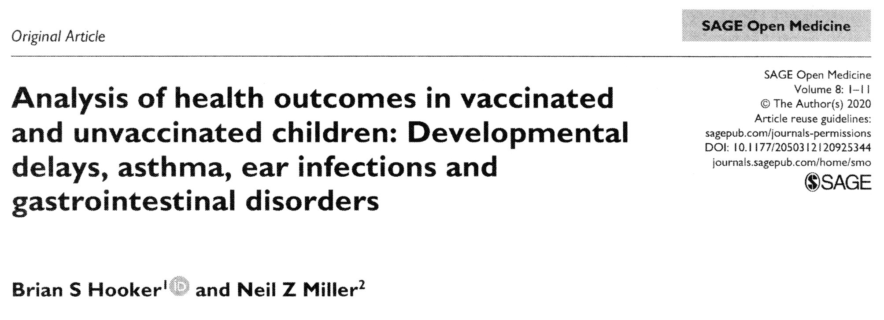
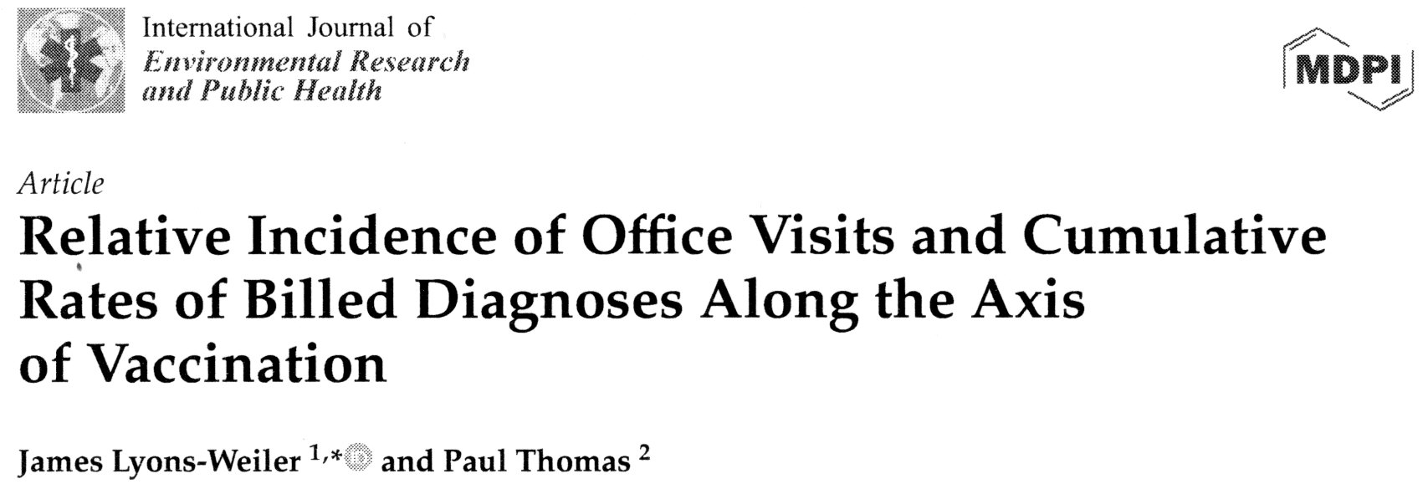
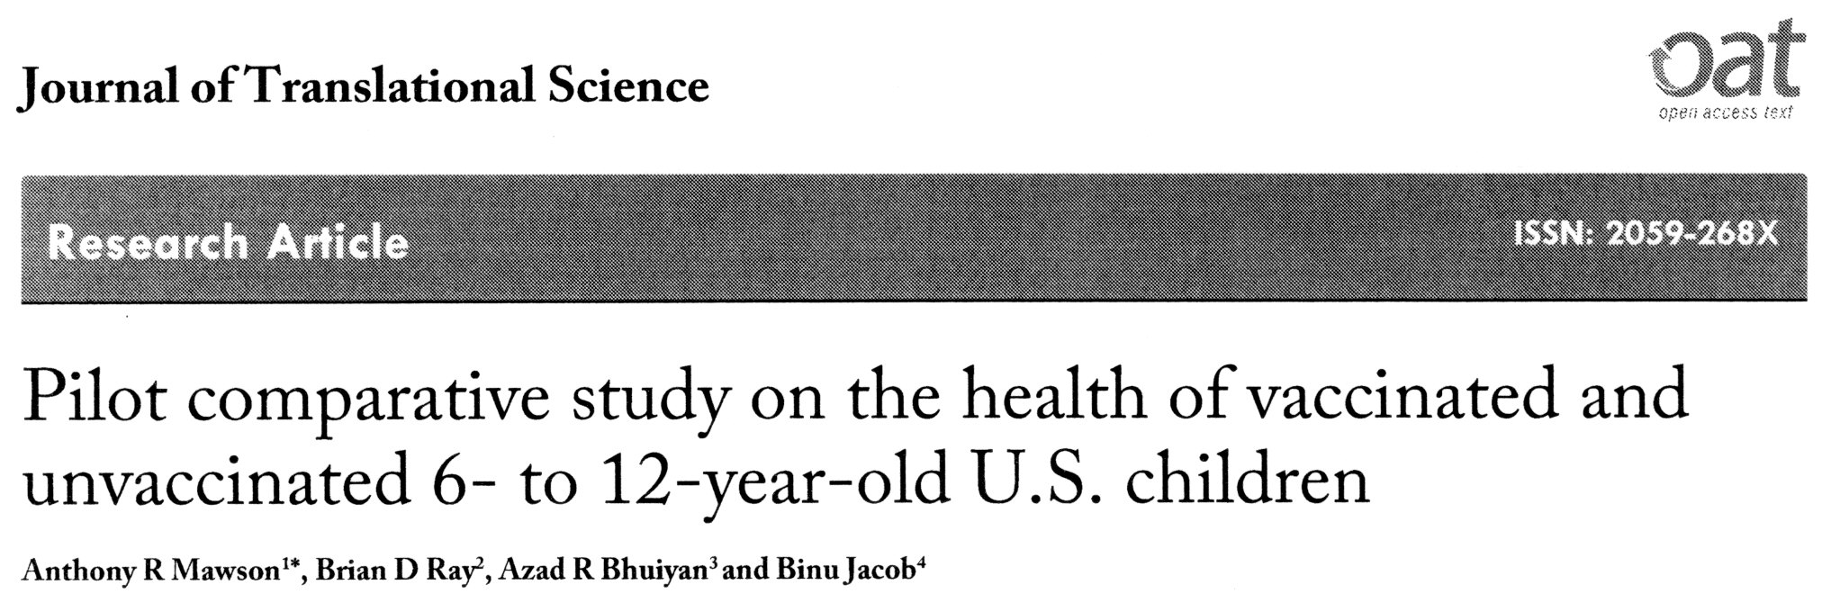
4 Peer-Reviewed Vaccinated vs. Unvaccinated Studies
● Hooker BS and Miller NZ (2021)
● Hooker BS and Miller NZ (2020)
● Lyons-Weiler J and Thomas P
(2020) [Retracted]
● Mawson AR, et al. (2017)
Copyright © NZM. All Rights Reserved.

Slide 17
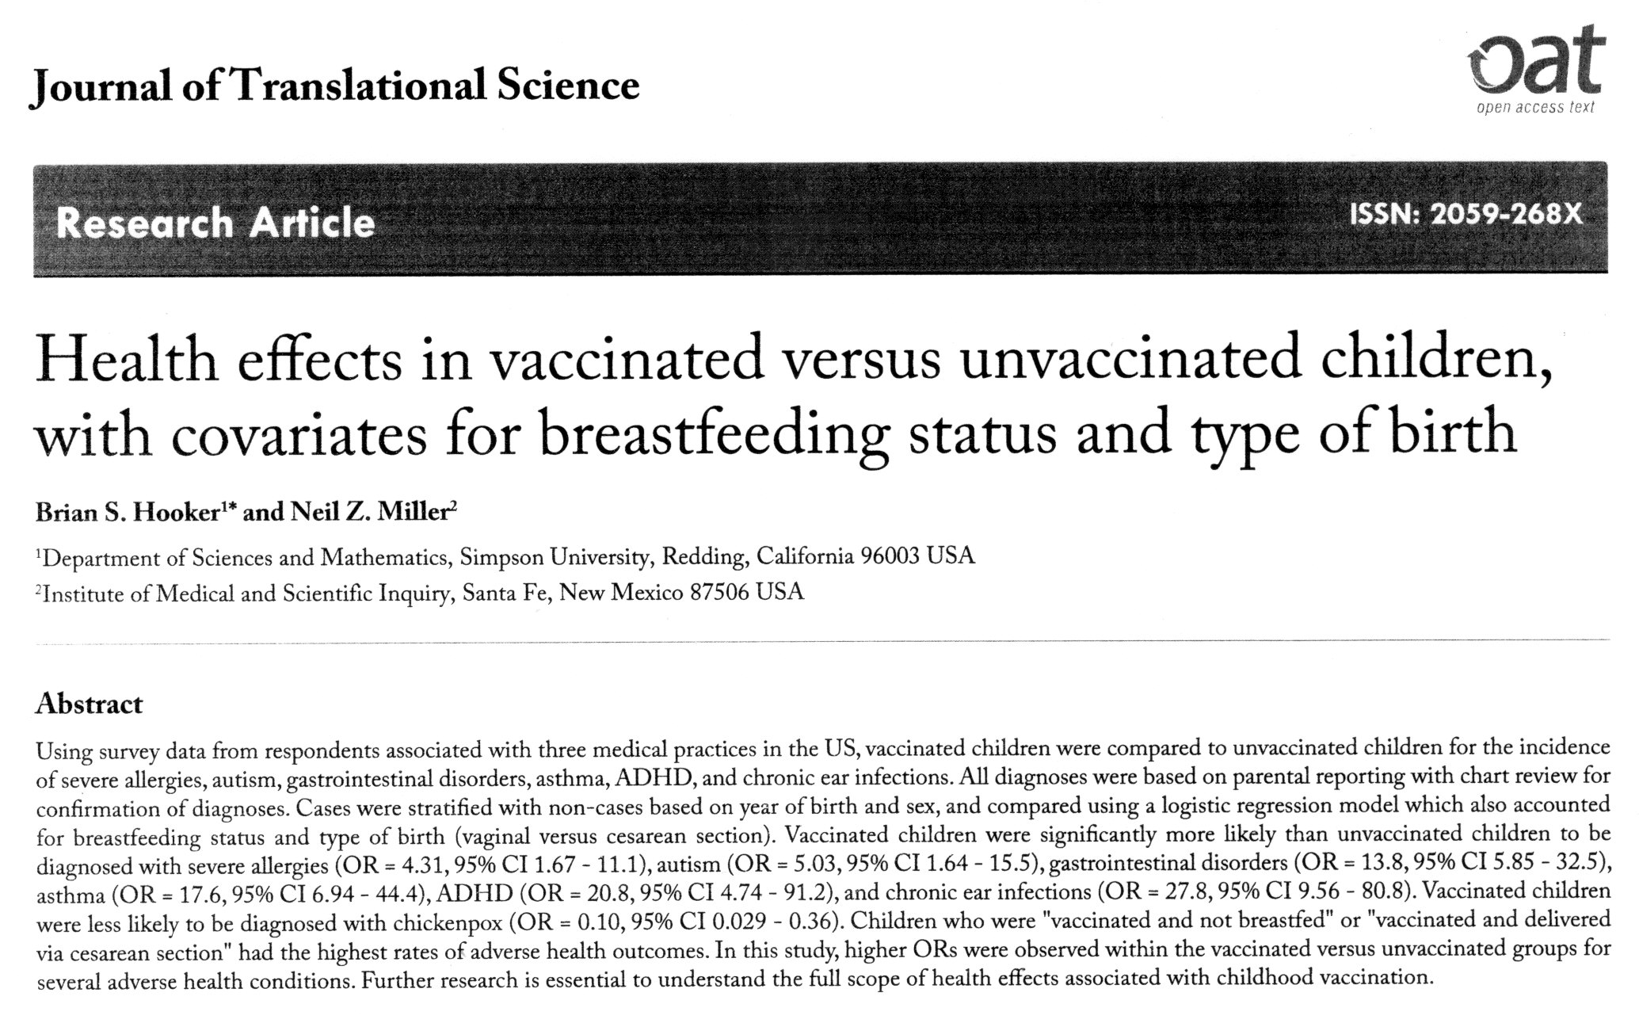
Hooker-Miller, Vaccinated vs. Unvaccinated (2021 study)
Copyright © NZM. All Rights Reserved.

Slide 18
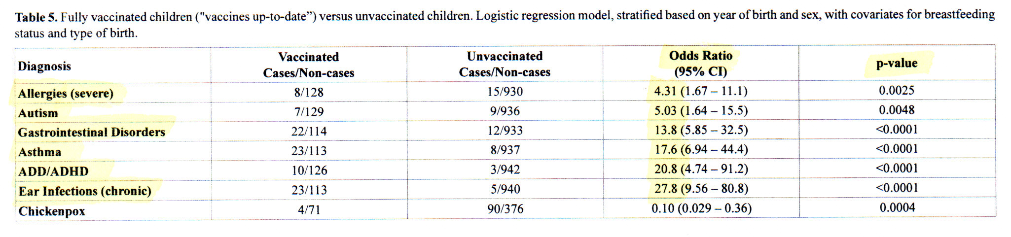
Hooker-Miller, Vaccinated vs. Unvaccinated (2021 study)
Table 5. Fully vaccinated children vs. unvaccinated children
All p-values are
highly significant.
• Vaccinated children were significantly more likely than unvaccinated children to develop adverse health conditions.
Copyright © NZM. All Rights Reserved.

Slide 19
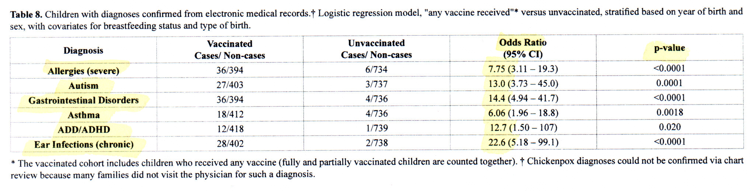
Hooker-Miller, Vaccinated vs. Unvaccinated (2021 study)
Table 8. Vaccinated children vs. unvaccinated children, with diagnoses confirmed from electronic medical records
All p-values are
highly significant.
• Vaccinated children were significantly more likely than unvaccinated children to develop adverse health conditions.
Copyright © NZM. All Rights Reserved.

Slide 20
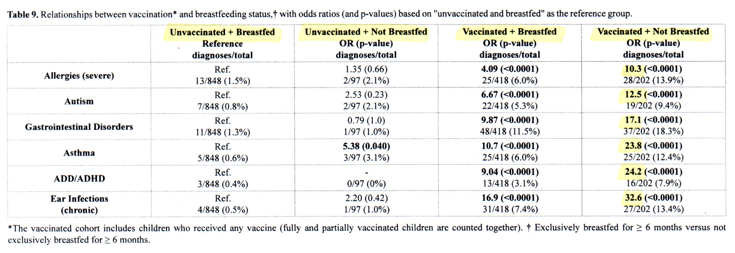
Hooker-Miller, Vaccinated vs. Unvaccinated (2021 study)
Table 9. Relationships between vaccination and breastfeeding
• In this analysis, children were placed into 4 groups.
• Children who were “Vaccinated & Not Breastfed” had the worst health outcomes.
• A consistent linear increase was observed for allergies, autism, asthma, and ear infections.
Copyright © NZM. All Rights Reserved.

Slide 21
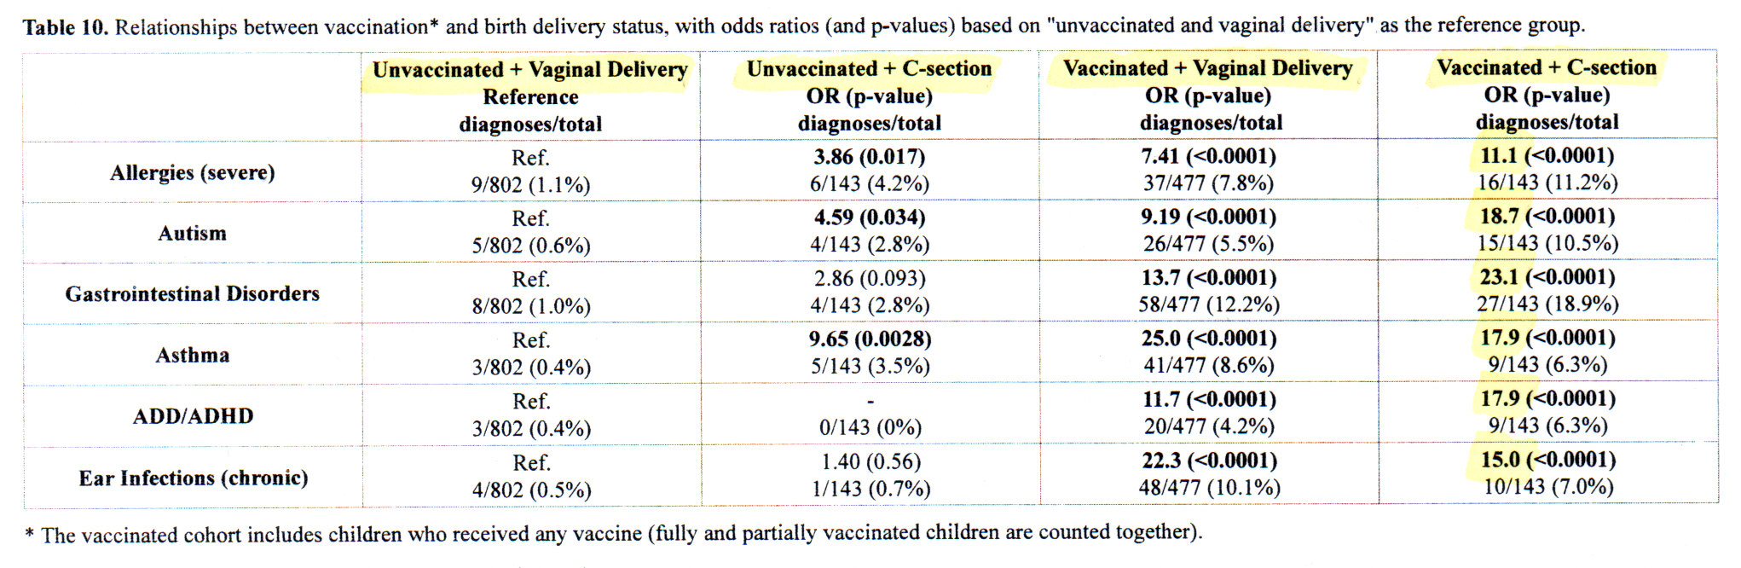
Hooker-Miller, Vaccinated vs. Unvaccinated (2021 study)
Table 10. Relationships between vaccination and birth delivery status
• In this analysis, children were placed into 4 groups.
• Children who were “Vaccinated & Born via C-Section” had the worst health outcomes.
• A consistent linear increase was observed for allergies, autism, and gastrointestinal disorders.
Copyright © NZM. All Rights Reserved.

Slide 22
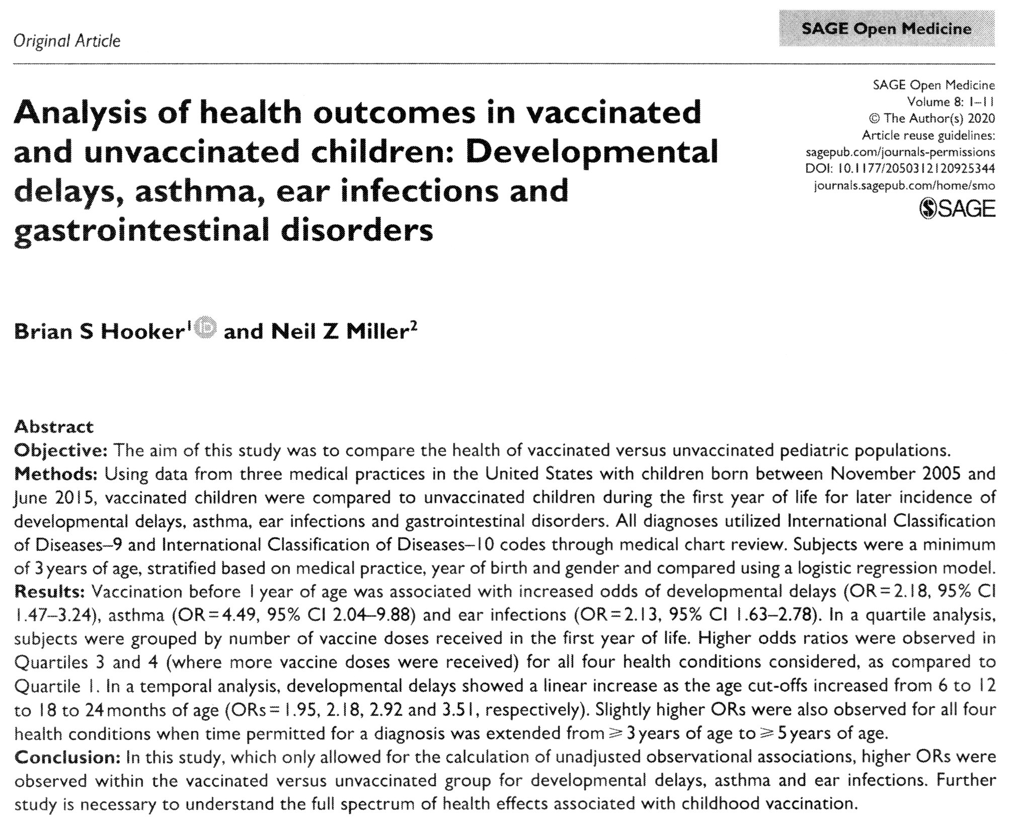
Hooker-Miller, Vaccinated vs. Unvaccinated (2020 study)
Copyright © NZM. All Rights Reserved.

Slide 23
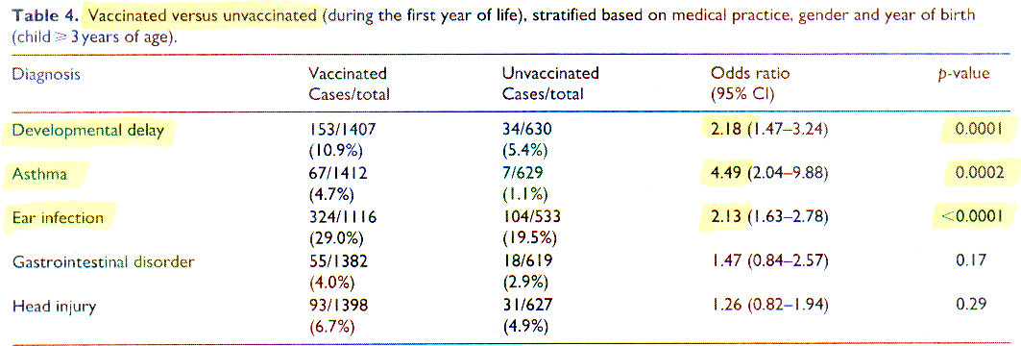
Hooker-Miller, Vaccinated vs. Unvaccinated (2020 study)
Table 4. Vaccinated vs. unvaccinated children
• Vaccinated children were significantly more likely than unvaccinated children to develop adverse health conditions.
Copyright © NZM. All Rights Reserved.

Slide 24
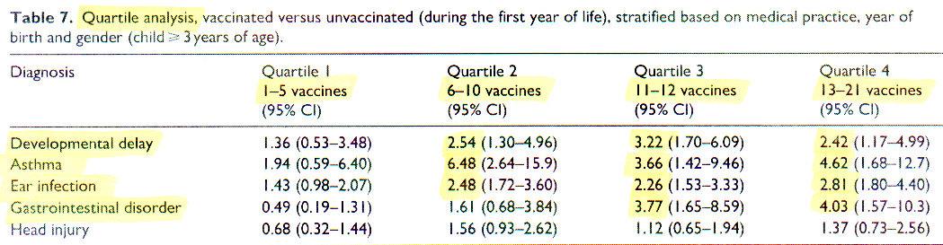
Hooker-Miller, Vaccinated vs. Unvaccinated (2020 study)
Table 7. Quartile analysis
• Vaccinated children were significantly more likely than unvaccinated children to develop adverse health conditions.
Copyright © NZM. All Rights Reserved.

Slide 25
Lyons-Weiler & Thomas, Vaccinated vs. Unvaccinated
(2020 study) [Retracted]
• In this study, vaccinated vs. unvaccinated children were assessed for billed office visits per adverse health outcome.
• Overall, unvaccinated children were found to be healthier than vaccinated children.
• This paper contains important findings despite retraction.
Copyright © NZM. All Rights Reserved.

Slide 26
“Anti-Vax” Studies are Being Targeted for Retraction
Elisha E, Guetzkow J, et al. Retraction of scientific papers: the case of vaccine research. Critical Public Health 2021; DOI: 10.1080/09581596.2021.1878109
● Research that contradicts official positions may be suppressed through censorship, restricted access to funding, and by retraction of papers from scientific journals after publication.
● Of 24 retracted papers on vaccines, all of them discussed safety concerns. None of the retracted papers had positive findings supporting vaccine safety.
● Anonymous complaints by proxies of the pharmaceutical industry pressure editors of scientific journals to retract papers that challenge pro-vaccine views.
● Retracting valid papers that challenge prevailing ideas is unethical, undermines scientific integrity, narrows our world view, and threatens public health.
Copyright © NZM. All Rights Reserved.

Slide 27
Mawson, et al., Vaccinated vs. Unvaccinated (2017 study)
● Vaccinated children were found to have significantly higher rates of allergies and neurodevelopmental disorders than unvaccinated children.
• Vaccinated children had higher rates of learning disability (OR = 5.2), ADHD (OR = 4.2), and autism (OR = 4.2).
Copyright © NZM. All Rights Reserved.

Slide 28

Top scientists in the United States regularly engage in scientific misconduct that threatens the integrity of science
Martinson BC, Anderson MS, de Vries R. Scientists behaving badly. Nature 2005 Jun 9; 435: 737-38.
“Our findings reveal a range of questionable practices that are striking in their breadth and prevalence. U.S. scientists engage in a range of behaviors extending far beyond fabrication, falsification or plagiarism that can damage the integrity of science.”
● Researchers surveyed 3,247 U.S. scientists funded by the National Institutes of Health (NIH).
● 33% admitted that they engaged in questionable scientific behavior during the previous 3 years.
● 16% changed the design, methodology or results of a study due to pressure from a funding source.
● 15% dropped data points from analyses.
Copyright © NZM. All Rights Reserved.

Slide 29

Most published medical studies are false
Ioannidis JP. Why most published research findings are false. PloS Med 2005 Aug; 2(8): e124.
“For most study designs and settings, it is more likely for a research claim to be false than true.”
● This paper demonstrates that MOST published research findings are false.
John Ioannidis, PhD
● Bias, which produces false findings, can occur from many factors, including choice of study design, manipulation in the analysis, or selective reporting of findings.
● Even large epidemiological studies may be false.
Copyright © NZM. All Rights Reserved.

Slide 30


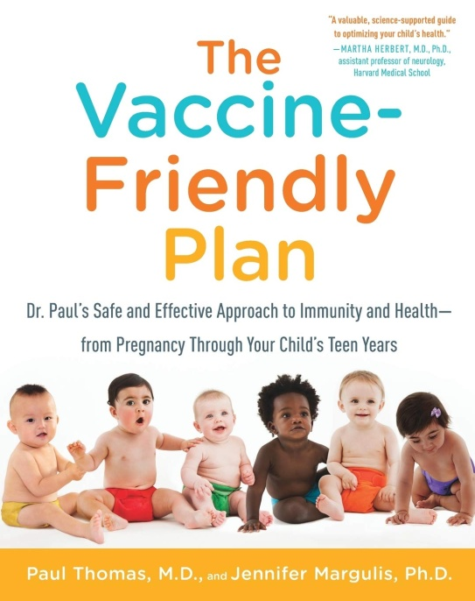
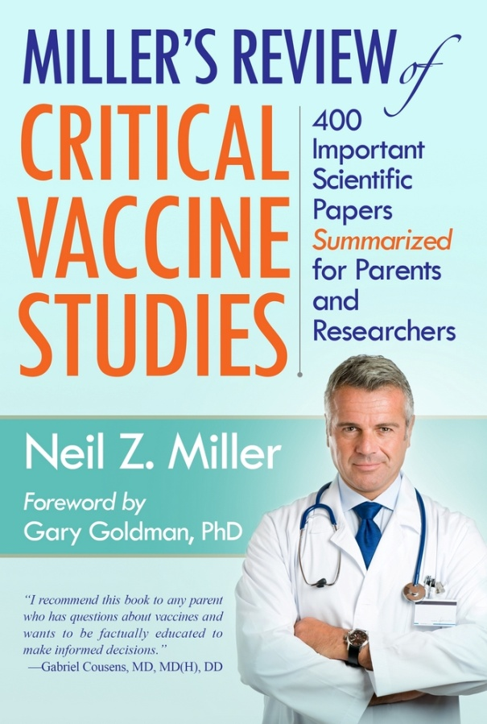
Paul Thomas with Neil Miller,
October 2021

