Slide 1
Paul Thomas Podcast
Slides for Josh Guetzkow Interview on the Israeli Experience, Pharma Criminality & Vitamin A Toxicity as Mechanism for Vaccine Damage

Slide 2
Eligibility for ‘Green Pass’
A week after second shot of RNA vaccine
Documented Recovery from COVID / Antibody Test
Ineligible for Vaccine (Exemptions are Unclear)
Negative PCR Test within 72 hours

Slide 3
Without a Green Pass You Cannot:
Sit indoors at restaurants and cafes
Shop at some stores and malls
Go to movies, theater, concerts or most sporting events
Go to the gym or indoor swimming pool
Stay at a hotel
Attend college classes in person
Be exempt from quarantine after exposure or return to country

Slide 4
Petition by Israeli Citizens to the International Criminal Court Charging Israel with Violation of Nuremberg Code

Slide 5
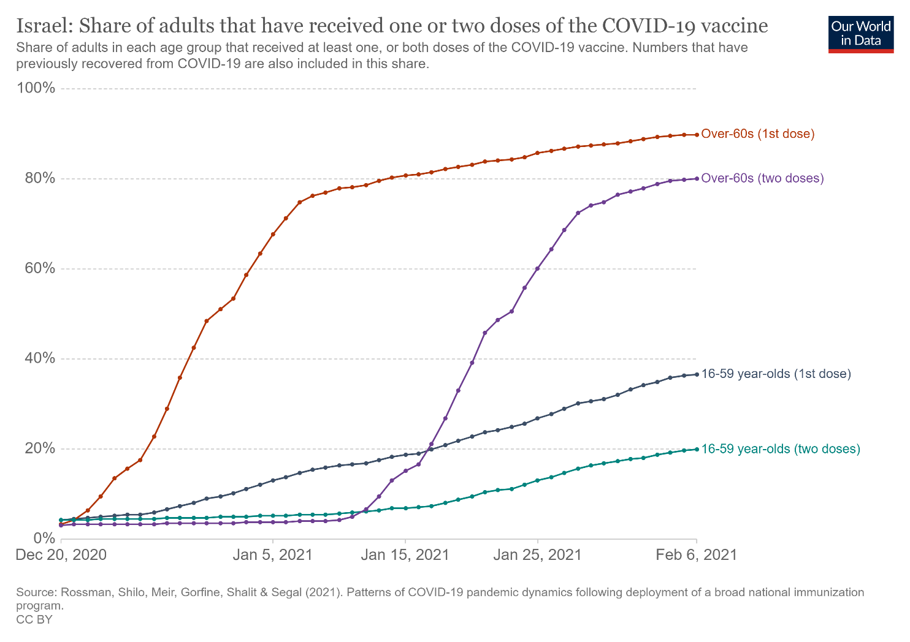
Vaccination Rates, Dec 20 – Feb 6

Slide 6
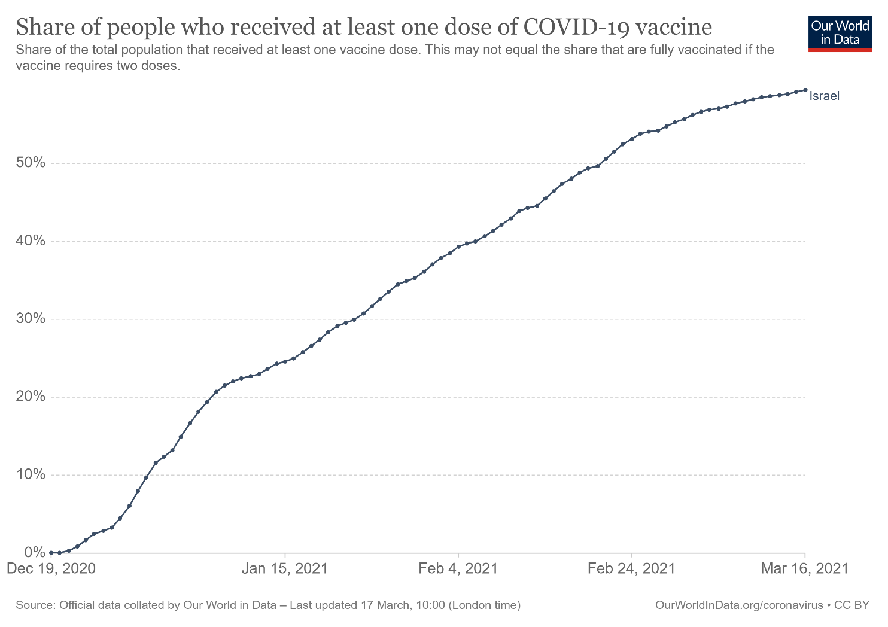
% Who Received at Least 1 Dose

Slide 8
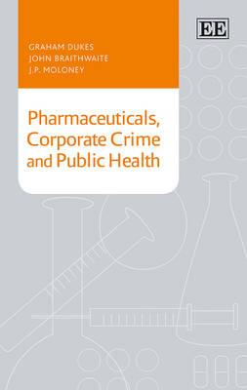




Slide 9
Mawson’s Theory of Vaccine Injury
“vaccinations [can] lead to cholestatic liver dysfunction, in which stored vitamin A compounds (retinyl esters, retinol and retinoic acid) enter the [blood] circulation in toxic concentrations; this induces endogenous forms of hypervitaminosis A, with the severity of adverse outcomes being directly proportional to the concentration of circulating retinoids.”

Slide 10
Mawson’s Papers Discussing The Theory

Slide 11
Signs and Symptoms of Gulf War Illness (GWI) and Chronic Hypervitaminosis A (CHA)
Major Signs/Symtpoms GWI CHA
Mood Swings, Irritability + +
Memory Loss, Lack of Concentration + +
Digestive, Stomach and Intestinal Disorders + +
Anxiety, Sleep Disturbances + +
Depression & Other Psych. Disorders + +
Muscular Pain, Weakness, General Fatigue + +
Headaches + +
Skin & Other Allergies + +
Respiratory Problems + +
Reproductive Disorders + +
Source: Mawson and Croft 2019, “Gulf War Illness: Unifying Hypothesis for a Continuing Health Problem,” Table 3.

Slide 12
Mawson’s Papers Have Linked Vitamin A to
Gout (1984)
Lupus and renal disease (1985)
Primary Biliary Cirrhosis (2000)
Asthma (2001)
Liver damage from Hep-B (2001)
Bone pain (2009)
Pathogenesis of: HIV (2007), influenza (2013), malaria (2013) and dengue fever (2014)
Chronic aggression (2009)
Childhood learning disorders, aggression and hyperactivity (ADHD) (2012)
Post-partum depression (2013) and premature births (2016)
Stevens-Johnson syndrome (2015)
Neurotoxicity of quinolone antimalarial drugs (2016)
Congenital rubella syndrome [similar to autism] (2019)
Source: Mawson’s Google Scholar Page

Slide 13
Studies on Vitamin A Pills & Creams

Slide 14
Research Has Shown that Vitamin A:
Is a Mitochondrial Toxicant
Is Neurotoxic and Reduces Serotonin Levels
Contributes to Endoplasmic Reticulum Stress (ERS)
Contributes to Celiac Disease
Contributes to IBD by promoting IL-8 and also to Ulcerative Colitis
Contributes to Dry Eye Disease (MBD)
Causes Hypothalamus–pituitary–adrenal (HPA) hyperactivity
Promotes pro-inflammatory cytokines IL-1β, IL-5, IL-6, IL-8, etc.
Inhibits Repair of Telomeres
And on and on and on…

Slide 15
Liver Releases Free Retinol Under
Inflammatory Stress

Slide 16
RDA and “Tolerable Upper Limit” of Daily Vitamin A (International Units)
AGE RDA Tolerable Upper Limit
0-3 1,000 IU 2,000 IU
4-8 1,320 IU 3,000 IU
9-13 2,000 IU 5,610 IU
14-18 2,310 IU 9,240 IU
18+ Women 2,310 IU 10,000 IU
18+ Men 3,000 IU 10,000 IU
Source: Web MD https://www.webmd.com/a-to-z-guides/supplement-guide-vitamin-a

Slide 17
Food Vitamin A Content (in IU)
1 sweet potato = 22,000
1 large carrot = 12,000
1 cup of kale = 10,000
1 red pepper = 5,000
1 tbs. of paprika = 3,500
1 cup spinach = 2,800
1 cup lettuce = 2,600
1 tsp. cod liver oil = 4,500 1 oz. beef liver = 7,300
1 oz. chicken liver = 4,000
100g cheddar cheese = 1,000
1 Centrum Adult = 3,500
1 Flintstone’s vitamin = 1,300
10 scoops of Similac = 1,300
Source: https://nutritiondata.self.com/

Slide 18
Grant Genereux’s Free e-Books www.ggenereux.blog

Slide 19
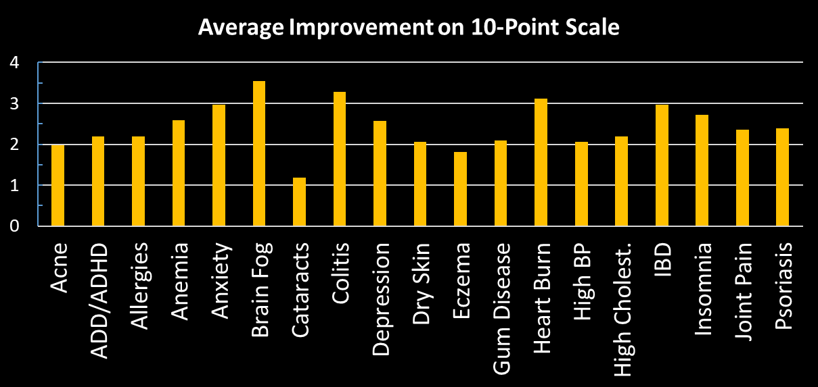
Selected Results from Survey of 125 People on Vitamin A Detox Diet
Source: www.ggenereux.blog

Slide 20
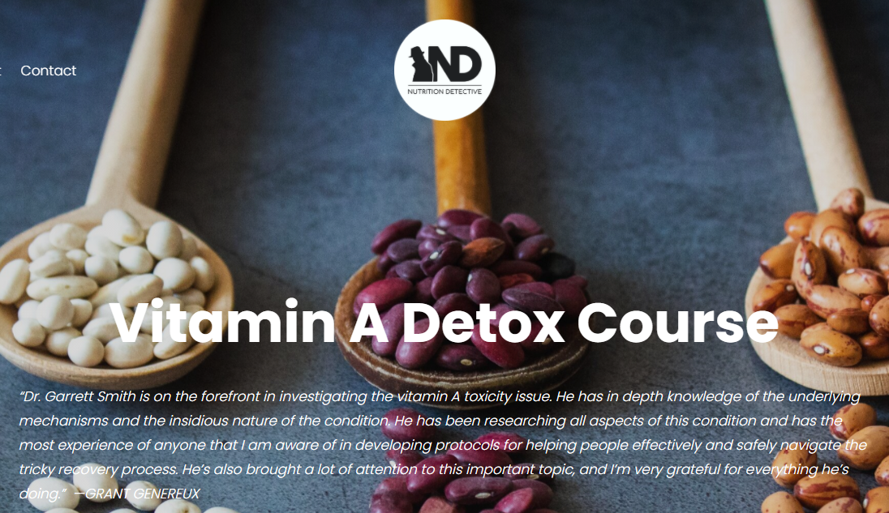
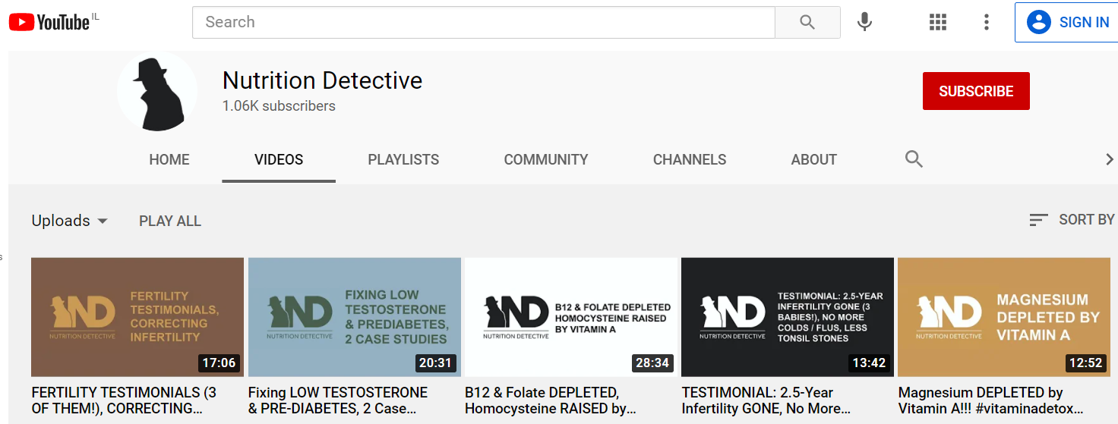
Vitamin A Detox Protocol www.NutrtionDetective.work

Slide 21
Contact Info & Further Details
E-mail: joshg99@gmail.com
More info on Vitamin A Toxicity & Vaccine Injuries:
tinyurl.com/VitAandVaxx
Statistics and Reports on COVID-19 Vaccine Injuries:
tinyurl.com/VaxInjuryCOVID19
Submit reports on suppression of vaccine dissent to:
VaxSuppression@gmail.com

