Slide 1
Flu vaccines and Aluminum Adjuvants
Cammy Benton, MD, IFMCP, ABIHM
Board Certified Family Medicine
Founding board member Physicians for Informed Consent

Slide 2

Physicians for Informed Consent
https://physiciansforinformedconsent.org/education/
Information sheets so far on Measles, MMR, Influenza, Aluminum Adjuvants, The Immunocompromised Schoolchild, and COVID-19.
https://www.bentonintegrative.com/post/patient-info-sheet-for-the-flu-vaccine

Slide 3

Who am I doing this for?

Slide 4
Flu Vaccine increases the Risk of Contracting a Non-Flu Respiratory Illness by 65%
Per CDC three-year study published in Vaccine
  65% increased risk of suffering from a non-flu acute respiratory illness within 14 days of receiving the vaccine. “Patients’ experiences of illness after vaccination may be validated by these results.”
    Rikin S, et al, Assessment of temporally related acute respiratory illness following influenza vaccine. Vaccine. 2018 Apr 5;36 (15) : 1958-64
More than 85% of acute respiratory illnesses do not involve the flu.

Slide 5
Effect of Flu Vaccination on Hospitalization?
NIH- funded a study that analyzed 170 million episodes of medical care and found that “no evidence indicated that vaccination reduced hospitalizations.”
  Anderson ML et al, The effect of influenza vaccination for the elderly on hospitalization and mortality: an observational study with a regression discontinuity design. Ann Intern Med. 2020 Apr 7;172(7):445-52
2018 Cochrane review of 52 clinical trials assessing the effectiveness of influenza vaccines did not find a significant difference in hospitalizations between vaccinated and unvaccinated adults.
  Demicheli V et al, Vaccines for preventing influenza illness in healthy adults. Cochrane Database Syst Rev 2018 Feb 1;2(2):CD001269
Mayo Clinic – case-control study – “trivalent inactivated influenza vaccine (TIV) is not effective in preventing laboratory-confirmed influenza-related hospitalization in children” age 6 months-18 years of age. Instead, “We found a threefold increased risk of hospitalization in subjects who did get the TIV vaccine.”
  Joshi AY Effectiveness of trivalent inactivated influenza vaccine influenza-related hospitalization in children: a case-control study. Allergy Asthma Proc. 2012 Mar-Apr;33(2):e23-7

Slide 6
Does it at least decrease transmission of influenza? No!
CDC funded a study of 328 households. The authors state, “There was no evidence that vaccination prevented household transmission once influenza was introduced.”
  Ohmit SE et al, Influenza vaccine effectiveness in the community and the household. Clin Infect Dis 2013 May;56(10):1363
Cochrane Library- Systematic review of 50 influenza vaccine studies states, “Influenza vaccines have a modest effect in reducing influenza symptoms and working days lost. There is no evidence that they affect complications, such as pneumonia, or transmission.”
  Jefferson T et al, Vaccines for preventing influenza in healthy adults. Cochrane Database of Syst Review 2010 Jul 7;(7):CD001260

Slide 7
Flu vaccine failures?
CDC studies flu vaccine successes/failures due to antigenic drift so it is based on a “best guess” of upcoming strains. It explains why people can get flu more than once due to the strains being just different enough.
Data from the CDC Influenza Vaccine Effectiveness (VE) network indicate a 65% vaccine failure rate between 2014-2018.
Repeat doses may increase vaccine failure risk! Some studies show low effectiveness in individuals vaccinated two years in row.
  Omit Se et al, Influenza effectiveness in the Community and Household. Clin Infect Dis 2013 May;56(10):1363

Slide 8
But the kids….
Before the widespread use of the influenza vaccines, between 2000-2003, kids under the age of 18 had a 0.00008% chance of dying from the flu.
Per the CDC, deaths from influenza are uncommon among children with and without high-risk conditions.

Slide 9
How about the adults?
A division of the Department of Health and Human Services (HHS), funded a study over 33 years to assess flu mortality from 1968-2001. The authors of the study state: “We could not correlate increasing vaccination coverage after 1980 with declining mortality rates in any age group… We conclude that the observational studies substantially overestimate vaccination benefit.”
  Simonsen L, et al, Impact of Influenza vaccination on seasonal mortality in the US elderly population. Arch Intern Med 2005 Feb 14;165(3):265-72
NIH study- 7.6 million deaths analyzed and found a “sharp increase in influenza vaccination rates at 65 years with no matching decrease in hospitalization or mortality rates.”
  Anderson ML et al, The effect of Influenza vaccination for the elderly on hospitalization and mortality: an observational study with a regression discontinuity design. Ann Intern Med 2020 Apr 7;172(7):445-52

Slide 10
What about the Health Care Workers (HCW)?
Cochrane review of 30 studies- “Our review findings have not identified conclusive evidence of benefit of HCW vaccination programs on specific outcomes of lab-proven influenza, its complications (lower respiratory infection, hospitalization or death due to lower respiratory tract illness) or all-cause mortality in people over the age of 60.” Authors conclude, “This review does not provide reasonable evidence to support the vaccination of healthcare workers to prevent influenza…There is little evidence to justify medical care and public health practitioners mandating influenza vaccination for healthcare workers.”
  Thomas RE et al, Influenza vaccination for Health care workers who care for people aged 60 and older living in long-term care institutions. Cochrane Database Syst Rev 2016 Jun 2;(6) :CD005187

Slide 11
Clearly the Flu vaccine mandates are critical in the Coronavirus pandemic, right?
The British Medical Journal published a Cochrane analysis “The large gap between policy and what the data tell us (when rigorously assembled and evaluated) is surprising… Evidence from Systemic reviews shows that inactivated vaccines have little or no effect on the effects measured. Reasons for the current gap between policy and evidence are unclear, but given the huge resources involved, a re-evaluation should be urgently undertaken.”
  Jefferson T et al. Influenza vaccination: policy versus evidence. BMJ 2006 Oct 28;333(7574); 912-5
“Vaccine derived virus interference was significantly associated with coronavirus and human metapneumovirus” There was a 36% increased risk of coronavirus in fact.
  Greg G Wolff. Influenza vaccination and respiratory virus interference among Department of Defense personnel during the 2017-2018 influenza season. Vaccine 2020 Jan 10;38(2):350-354.

Slide 12
Aluminum Adjuvants-The whats and the whys
Aluminum is the most abundant metal in the Earth’s crust, found in the soil and has no known natural biological function. Now found in processed foods, baby formulas, deodorants, antacids, allergy shots and vaccines.
In vaccines, we use aluminum salts as adjuvants to enhance immune response to an antigen (foreign substance). The US FDA says the antigens are necessary to trigger the immune response.
Can we over or under trigger that immune response?

Slide 13
Aluminum containing vaccines
Hepatitis B
DTaP and Tdap (diphtheria, pertussis, and tetanus)
Haemophilus Influenza type b
Pneumococcal
Hepatitis A
Human Papilloma virus
Meningococcal B

Slide 14
Are the aluminum salts safe in vaccines?
FDA- aluminum GRAS status (generally recognized as safe) since 1975. Prior to 1990, technology did not exist to measure the quantities and the absorption.
Since 1990, discoveries support effects on the nervous system and other parts of the body, the most noticeable range from motor skill impairment to encephalopathy which is listed in all the inserts.
FDA 2003- “The agency is concerned that young children and children with immature renal function are at a higher risk resulting from any exposure to aluminum.”
  US Food and Drug Administration, Department of Health and Human Services. Rules and regulations. Fed Regist 2003 Jun;68(100):342286

Slide 15
Safety limits?
Agency for Toxic Substances and Disease Registry (ATSDR) 2008- studies of neurotoxic effects of aluminum – to avoid aluminum’s negative effects, use no more than 1000 mcg (1 mg) of aluminum per kg of body weight as it can lead to “alterations in motor function, sensory function, and cognitive function,” per the DHHS.
  ATSDR Toxicological profile for aluminum. Washington DC: US DHHS; 2008.3, 13-24, 145 171-7, 208.

Slide 16
Oral versus injected aluminum. Big difference!
Oral- The 1000 mcg limit of aluminum is based on 0.1% oral absorption in which the digestive tract blocks nearly all aluminum.
Intramuscular (IM)- 100% may be absorbed over time so 1000 times greater than oral absorption.
After conversion of oral to injected, to avoid neurotoxic effects of aluminum, no more than 1 microgram of aluminum per Kg of body weight should enter the blood stream on a daily basis.

Slide 17
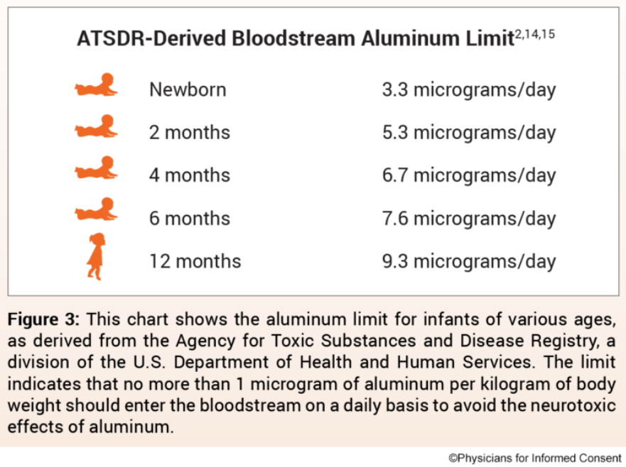
Aluminum limits based on age

Slide 18
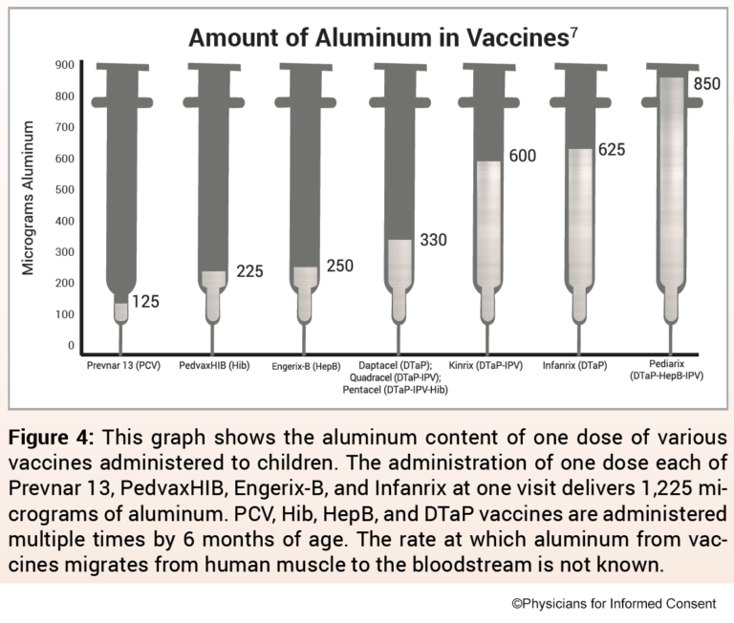
Amount in vaccines

Slide 19
Where are the safety studies on aluminum?
2011 study compared the amount of aluminum in vaccines to the ATSDR derived bloodstream limits- incorrectly based calculations on 0.78% of oral aluminum being absorbed versus the 0.1% that was determined earlier resulting in nearly 8 times more aluminum being allowed to enter the blood stream. So a faulty study!
We don’t know! Does it take months or a year or more? Either way, the cumulative exposure from vaccines under age 1 exceeds the ATSDR-derived daily limit by several hundreds.
Studies have shown that aluminum from vaccines is absorbed by immune cells that travel to distant parts of the body, including the brain.
  Masson JD, et al, Critical analysis of reference studies on the toxicokinetics of aluminum based adjuvants. J Inorg Biochem 2018 Apr;181:87-95

Slide 20
What now?
Studies do not support mandates since there is more risk and less efficacy than is realized by the public.
Where there is a risk, there must be a choice that is not coerced in any way.
Book recommendations-
  Tale of Two Sides by John Phillip Ryan (aka Bob Sears MD) (the best conversation on informed consent out there in very friendly language)
  The Vaccine Friendly Plan by Paul Thomas MD (more moderate schedule)
  Dissolving Illusions by Suzanne Humphries MD (amazing but a little slow until you get to the Polio chapter)
  The Vaccine Epidemic by Mary Holland JD
  The HPV Vaccine on Trial by Mary Holland JD
  Raising a Vaccine Free Child by Wendy Lydall
  The Unvaccinated Child-A treatment Guide for Parents and Caregivers Thompson ND

Slide 21


