Slide 1
Health Outcomes of Vaccinated versus Unvaccinated Children
Brian S. Hooker, Ph.D., P.E.
September 18, 2020

Slide 2
We are surrounded by sick children
54% of all children in the U.S. have been diagnosed with a chronic disorder
1 in 6 children has been diagnosed with a neurodevelopmental disability
At least 1 in 54 children have been diagnosed with autism or autism spectrum disorder
There has been an explosive increase in these disorders since the early 1990s

Slide 3
Despite multiple calls for such a study, U.S. government officials refuse to do this comparison
Claim that these data are not available –
False – Even the CDC’s Vaccine Safety Datalink includes unvaccinated children.
Claim that the only useful study would be a double-blinded placebo study where vaccines would be withheld from some children without their knowledge
False - Retrospective studies are completed all of the time by CDC and other HHS scientists and serve as the gold standard in post-marketing surveillance

Slide 4
Past Vax-Unvax Studies
Mawson et al. 2017 – Journal of Translational Science
  Based on parental survey of homeschool children
  Show significant relationships for pneumonia, otitis media, allergies and neurodevelopmental disorders
Institute of Medicine Report (2001)
  Relationship between multiple vaccinations and sudden unexpected death as well as Type 1 diabetes
Institute of Medicine Report (2011)
  Out of 158 types of vaccine adverse events, evidence was insufficient to judge a relationship in 135 such events
Compilation of Vax-Unvax Studies – Children’s Health Defense
  https://childrenshealthdefense.org/wp-content/uploads/Vaxxed-Unvaxxed-Full-Presentation-Parts-I-VII.pdf

Slide 5
Pediatric Health Outcomes Initiative (PHOI)
PHOI is a collaboration of physicians and scientists to investigate the relationship between vaccination and health outcomes in children
PHOI is conducting both prospective and retrospective studies directly using chart data from participating medical practices
Three pediatrics practices in the U.S. provided the patient data for this current study
Patients considered for the study were born between November 2005 and June 2015

Slide 6

Neil Z. Miller - Coauthor
Medical research journalist with 30 years dedicated to vaccine safety education
Author of vaccine books:
  Miller’s Review of Critical Vaccine Studies
  Vaccine Safety Manual for Concerned Families
  Make an Informed Vaccine Decision (w Mayer Eisenstein, MD)
  Vaccines: Are They Really Safe and Effective?
  Vaccines, Autism and Childhood Disorders
Author/coauthor of scientific papers

Slide 7
Conditions considered for analysis
Diagnosis | ICD-9 Code(s) | ICD-10 Code(s) | Description
Developmental Delay | 315 | F80, F81, F82 | Specific delays in development
Asthma | 493 | J45 | Asthma, excludes wheezing, not otherwise specified
Ear Infection | 382 | H66, H67 | Suppurative and unspecified otitis media
Gastrointestinal Disorder | 555 – 558 | K50 – K52 | Non-infective enteritis or colitis
Head Injury | 959.01 | S00 – S09 | Head Injury (non-specific)

Slide 8
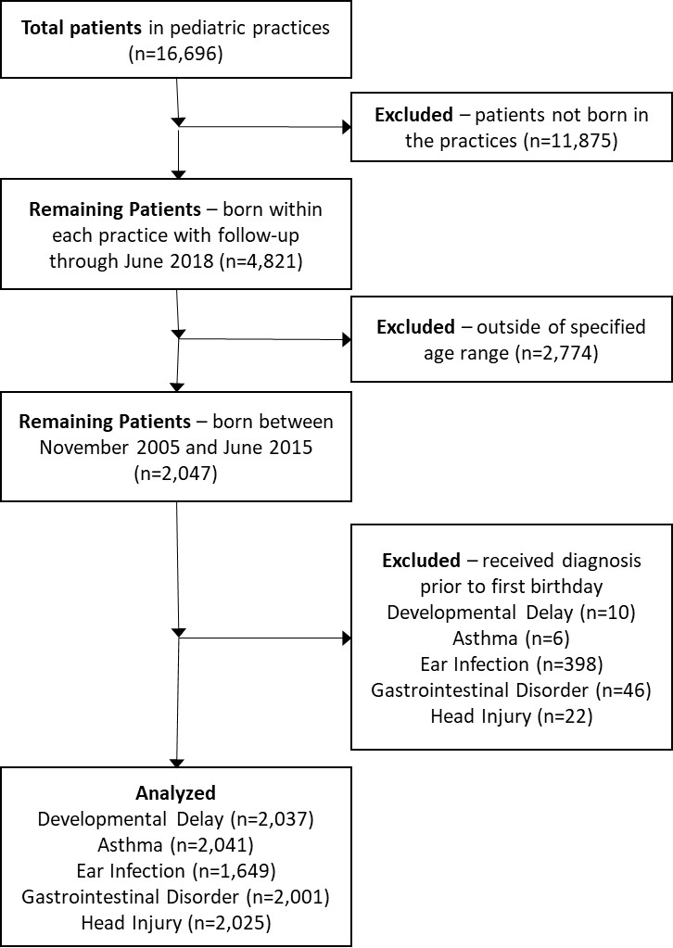

Slide 9
Characteristics of the Cohort
Category | Male | Female | Total
Total Sample | 2483 | 2338 | 4821
Over 3 years old | 1063 | 984 | 2047
Unvaccinated by age 1 | 345 | 288 | 633 (30.9%)
Vaccinated by age 1 | 718 | 696 | 1414 (69.1%)
First Vaccine after 1 | 64 | 39 | 103 (16.3%)*
Developmental Delay | 140 | 57 | 197 (9.6%)
Asthma | 48 | 32 | 80 (3.9%)
Ear Infection | 451 | 375 | 826 (40.4%)
Gastrointestinal Disorder | 64 | 55 | 119 (5.8%)
Head Injury | 83 | 63 | 146 (7.1%)

Slide 10
Additional Demographic Data
Variable | Mean | Standard Deviation | Minimum | Maximum
Number of vaccines (vaccinated by age 1) | 8.9 | 4.1 | 1 | 21
Age of first vaccine (days, vaccinated by age 1) | 102 | 65 | 2 | 380
Age as of June 2018 (years) | 5.6 | 2.2 | 3 | 12.8
Age of Developmental Delay Diagnosis (years) | 2.1 | 1.3 | 0.31 | 6.3
Age of Asthma Diagnosis (years) | 3.2 | 1.7 | 0.75 | 7.2
Age of Ear Infection Diagnosis (years) | 1.4 | 1.3 | 0.01 | 12.0
Age of Gastrointestinal Disorder Diagnosis (years) | 1.8 | 1.5 | 0.07 | 11.2
Age of Head Injury Diagnosis (years) | 2.8 | 2.1 | 0.09 | 10.2

Slide 11
Statistical Model
A logistic regression model was used to evaluate each condition studied
Strata were included for year of birth, gender and medical practice
No covariates were used in the model due to lack of direct patient demographic data
Vaccinated patients received at least one vaccine prior to their first birthday plus 15 days
Unvaccinated patients received no vaccines prior to their first birthday plus 15 days

Slide 12
Main Analysis Results
Diagnosis | Vaccinated Cases/Total | Unvaccinated Cases/Total | Odds Ratio (95% CI) | P-value
Developmental Delay | 153/1407 (10.9%) | 34/630 (5.4%) | 2.18 (1.47 – 3.24) | 0.0001
Asthma | 67/1412 (4.7%) | 7/629 (1.1%) | 4.49 (2.04 – 9.88) | 0.0002
Ear Infection | 324/1116 (29.0%) | 104/533 (19.5%) | 2.13 (1.63 – 2.78) | <0.0001
Gastrointestinal Disorder | 55/1382 (4.0%) | 18/619 (2.9%) | 1.47 (0.84 – 2.57) | 0.17
Head Injury | 93/1398 (6.7%) | 31/627 (4.9%) | 1.26 (0.82 – 1.94) | 0.29

Slide 13
Males only
Diagnosis | Vaccinated Cases/Total | Unvaccinated Cases/Total | Odds Ratio (95% CI) | P-value
Developmental Delay | 107/714 (15.0%) | 27/343 (7.9%) | 1.92 (1.21 – 3.04) | 0.0054
Asthma | 40/716 (5.6%) | 3/342 (0.9%) | 6.89 (2.10 – 22.6) | 0.0015
Ear Infection | 170/554 (30.7%) | 62/290 (21.4%) | 2.07 (1.45 – 2.57) | <0.0001
Gastrointestinal Disorder | 29/701 (4.1%) | 10/337 (3.0%) | 1.51 (0.70 – 3.23) | 0.29
Head Injury | 51/710 (7.2%) | 21/342 (6.1%) | 1.05 (0.61 – 1.80) | 0.87

Slide 14
Females Only
Diagnosis | Vaccinated Cases/Total | Unvaccinated Cases/Total | Odds Ratio (95% CI) | P-value
Developmental Delay | 46/693 (6.6%) | 7/287 (2.4%) | 3.10 (1.37 – 7.01) | 0.0068
Asthma | 27/696 (3.9%) | 4/287 (1.4%) | 2.70 (0.93 – 7.87) | 0.068
Ear Infection | 154/562 (27.4%) | 42/243 (17.3%) | 2.20 (1.48 – 3.26) | <0.0001
Gastrointestinal Disorder | 26/681 (3.8%) | 8/282 (2.8%) | 1.44 (0.64 – 3.25) | 0.39
Head Injury | 42/688 (6.1%) | 10/285 (3.5%) | 1.69 (0.83 – 3.43) | 0.15

Slide 15
Quartile Analysis
Vaccinated children were divided into quartiles based on the number of vaccines received prior to age one year and 15 days
These quartiles were compared directly to the unvaccinated portion of the cohort via logistic regression

Slide 16
Number of Vaccines by Quartile
Diagnosis | Quartile 1 1-5 Vaccines (95% CI) | Quartile 2 6-10 Vaccines (95% CI) | Quartile 3 11-12 Vaccines (95% CI) | Quartile 4 13-21 Vaccines (95% CI)
Developmental Delay | 1.36 (0.53 – 3.48) | 2.54 (1.30 – 4.96) | 3.22 (1.70 – 6.09) | 2.42 (1.17 – 4.99)
Asthma | 1.94 (0.59 – 6.40) | 6.48 (2.64 – 15.9) | 3.66 (1.42 – 9.46) | 4.62 (1.68 – 12.7)
Ear Infection | 1.43 (0.98 – 2.07) | 2.48 (1.72 – 3.60) | 2.26 (1.53 – 3.33) | 2.81 (1.80 – 4.40)
Gastrointestinal Disorder | 0.49 (0.19 – 1.31) | 1.61 (0.68 – 3.84) | 3.77 (1.65 – 8.59) | 4.03 (1.57 – 10.3)
Head Injury | 0.68 (0.32 – 1.44) | 1.56 (0.93 – 2.62) | 1.12 (0.65 – 1.94) | 1.37 (0.73 – 2.56)

Slide 17
Temporal analyses
The vaccinated cohort was divided by age of their first vaccine (6 months, 12 months, 18 months and 24 months)
These groups were compared to unvaccinated children within the same timeframe

Slide 18
Temporal Analysis of Vaccination
Diagnosis | 6 months (95% CI) | 12 months (95% CI) | 18 months (95% CI) | 24 months (95% CI)
Developmental Delay | 1.95 (1.35 – 2.84) | 2.18 (1.47 – 3.24) | 2.92 (1.81 – 4.72) | 3.51 (1.94 – 6.35)
Asthma | 3.10 (1.64 – 5.85) | 4.49 (2.04 – 9.88) | 3.74 (1.69 – 8.28) | 5.99 (2.15 – 16.7)
Ear Infection | 1.97 (1.58 – 2.46) | 2.13 (1.63 – 2.78) | 2.22 (1.61 – 3.05) | 2.08 (1.42 – 3.04)
Gastrointestinal Disorder | 2.02 (1.23 – 3.33) | 1.48 (0.84 – 2.57) | 1.45 (0.74 – 2.82) | 1.25 (0.60 – 1.45)
Head Injury | 1.32 (0.88 – 1.99) | 1.26 (0.82 – 1.94) | 1.77 (1.04 – 3.01) | 1.29 (0.73 – 2.29)

Slide 19
Repeat of the Main Analysis with a Higher Age Cut-Off
Children in this analysis were followed in each medical practice for a minimum of five years
Vaccination status was still based on vaccines received in the first year of life only

Slide 20
Children at least 5 years of age
Diagnosis | Vaccinated Cases/Total | Unvaccinated Cases/Total | Odds Ratio (95% CI) | P-value
Developmental Delay | 83/800 (10.4%) | 14/272 (5.1%) | 2.36 (1.29 – 4.31) | 0.0051
Asthma | 45/803 (5.6%) | 4/273 (1.5%) | 4.93 (1.75 – 13.9) | 0.0026
Ear Infection | 168/648 (25.9%) | 40/235 (17.0%) | 2.49 (1.65 – 3.76) | <0.0001
Gastrointestinal Disorder | 37/776 (6.5%) | 6/268 (2.2%) | 2.48 (1.02 – 6.02) | 0.045
Head Injury | 63/797 (7.9%) | 16/270 (5.9%) | 1.58 (0.89 – 2.81) | 0.12

Slide 21
Summary of Results
Consistent relationships were seen between vaccination status and developmental delays, asthma and ear infections
Additional relationships were seen for gastrointestinal issues in the quartile analysis and the temporal analysis (this relationship appeared in early vaccination as well as with more vaccines given)
“Healthy User Bias” was seen in the quartile analysis for developmental delays and asthma
All relationships were significant when the patient follow-up age was 5 years or above
No relationship was seen for the control diagnosis (head injury)

Slide 22
How does this compare to past work?
Mawson et al. 2017 also saw relationships between vaccination status and neurodevelopmental disorders, ear infections and allergies
An association between vaccination and developmental delays has been seen in multiple publications (Gallagher et al. 2010, Young et al. 2008, etc.)

Slide 23
Study Strengths
This study was based on medical chart records based on diagnoses given directly by pediatricians
All patients were continuously followed up for a minimum of three years from birth
Vaccination status was also based on diagnostic codes used in patient records
Healthcare seeking behavior was accounted for in the control diagnosis (head injury)

Slide 24
Study Limitations
No attempt was made to differentiate between different types of vaccines given (live virus, adjuvanted, multivalent, etc.)
Covariate data were not available (birth weight, gestational age, patient and parent demographic data, etc.)
Vaccination status was determined based only on vaccines received prior to one year of age
Small size and nature of cohort limited the ability to look at specific developmental disorders (autism, ADD/ADHD, tics, etc.)

Slide 25
The great unknown
The safety of the vaccination schedule along with the individual vaccines is woefully understudied
The U.S. Institute of Medicine in 2011 looked at 154 adverse reactions from 8 different vaccines and had insufficient data to rule out 138 of the reactions
This included the inability to rule out a relationship between the DTaP vaccine and autism
Another report by the U.S. Institute of Medicine in 2013 stated, “No studies have compared the differences in health outcomes that some stakeholders questioned between entirely unimmunized populations of children and fully immunized children.”

Slide 26
Vaccine adverse reactions are not rare!
A study commissioned by the U.S. CDC by Harvard Pilgrim Health Group in order to automate the VAERS database.
Out of 1.4 million vaccines given, 35570 potentially serious adverse events were reported (2.6%).
Some estimates show adverse events as high as 10%.
The CDC refused to move forward with Harvard Pilgrim and did not renew the grant to automate VAERS.
The CDC simply does not want to know this information.

Slide 27
Take home messages
Relationships were seen between vaccination and developmental delays, asthma and ear infections
Children receiving more vaccines or vaccinated earlier also were diagnosed with gastrointestinal issues
Much more study is needed to understand the long term effects of vaccination in children
Full paper published in: SAGE Open Medicine, https://journals.sagepub.com/home/smo

Slide 28
Acknowledgements
Mr. Neil Z Miller – Institute of Medical and Scientific Inquiry (coauthor)
Children’s Health Defense – childrenshealthdefense.org
Pediatric Health Outcomes Initiative (PHOI)

Slide 29


